Slide 1
Chapter 1
Community and Public Health: Yesterday, Today, and Tomorrow

Slide 2
Chapter Objectives
After studying this chapter, you will be able to:
Define the terms health, community, community health, population health, public health, public health system, and global health.
Briefly describe the five major determinants of health.
Explain the difference between personal and community health activities.
List and discuss the factors that influence a community’ s health.
Briefly relate the history of community and public health, including the recent U.S. history of community and public health in the twentieth and early twenty-first centuries.
Provide a brief overview of the current health status of Americans.
Describe the purpose of the Healthy People 2020 goals and objectives as they apply to the planning process of the health of Americans.
Describe the major community and public health problems facing the United States and the world today.

Slide 3
Introduction
Much progress made over last 100 years in health and life expectancy
Still room for improvement
Achievement of good health is worldwide goal of 21st century
Requires individual actions to improve personal health and organized community actions

Slide 4
20th Century Achievements in Public Health
Vaccination
Motor vehicle safety
Control of infectious diseases
Decline of deaths from CHD and stroke
Healthier mothers and babies
Safer and healthier foods
Safer workplaces
Family planning
Fluoridation of drinking water
Recognition of tobacco use as a health hazard

Slide 5
Definition: Health
Can mean different things to different people
A dynamic state or condition of the human organism that is multidimensional in nature, a resource for living, and results from a person’s interactions with and adaptations to his or her environment

Slide 6
Definition: Community
A group of people who have common characteristics
Can be defined by location, race, ethnicity, age, occupation, interest in particular problems or outcomes, or common bonds
Characterized by
Membership, common symbol systems, shared values and norms, mutual influence, shared needs and commitment to meeting them, shared emotional connection

Slide 7
Other Definitions (1 of 2)
Public health – actions that society takes collectively to ensure that the conditions in which people can be healthy can occur; most inclusive term
Community health – health status of a defined group of people and the actions and conditions to promote, protect, and preserve their health
Population health – health outcomes of a group of individuals, including the distribution of such outcomes within the group

Slide 8
Other Definitions (2 of 2)
Global health – health problems, issues, and concerns that transcend national boundaries
May be influenced by circumstances or experiences in other countries
Best addressed by cooperative actions and solutions

Slide 9
Personal Health Activities Versus Community/Public Health Activities
Personal health activities
Individual actions and decision making that affect the health of an individual or his or her immediate family members or friends
Community/public health activities
Activities aimed at protecting or improving the health of a population or community
Maintaining birth and death records, protecting food and water supply, etc.

Slide 10
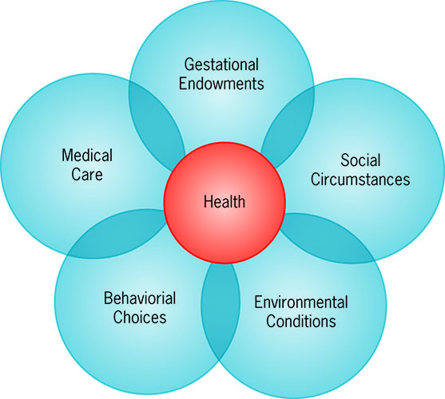
Factors that Affect the Health of a Community
Physical
Social and Cultural
Interconnections of the determinants of health.

Slide 11
Physical Factors
Geography
Environment
Community size
Industrial development

Slide 12
Social and Cultural Factors
Beliefs, traditions, and prejudices
Economy
Politics
Religion
Social norms
Socioeconomic status

Slide 13
Community Organizing
A process through which communities are helped to identify common problems or goals, mobilize resources, and in other ways develop and implement strategies for reaching the goals they have collectively set
Is not a science, but an art of consensus building within a democratic process

Slide 14
Individual Behavior
Takes the concerted effort of many individuals to make a program work
Herd immunity
The resistance of a population to the spread of an infectious agent based on the immunity of a high proportion of individuals

Slide 15
A History of Community and Public Health
Almost as long as the history of civilization
Knowledge of the past helps us better prepare for future community health challenges

Slide 16
Earliest Civilizations
Many community health practices went unrecorded
Practices may have involved taboos, rites, and spiritual beliefs
Archeological evidence of community health activities dating back to 2000 B.C.E.

Slide 17
The Eighteenth Century
Characterized by industrial growth
Cities overcrowded, water supplies inadequate and unsanitary, problems with trash, workplaces unsafe
1796: Dr. Jenner demonstrated process of vaccination against smallpox
First census taken: 1790

Slide 18
The Second Half of the Nineteenth Century
Epidemic problems in major cities
London cholera epidemics and Dr. John Snow
Many scientific discoveries
1850: Shattuck report
1850: Modern era of public health begins

Slide 19
The Twentieth Century
1900: life expectancy less than 50 years
Leading causes of death were communicable diseases
Vitamin deficiencies and poor dental health common in slums

Slide 20
Health Resources Development Period (1900-1960)
Growth of healthcare facilities and providers
Reform phase (1900-1920)
1920s
Great Depression and WWII
Postwar years

Slide 21
Period of Social Engineering (1960-1973)
Federal government became active in health matters
1965: Medicare and Medicaid established
Improved standards in health facilities
Influx of federal dollars accelerated rate of increase in cost of health care

Slide 22
Period of Health Promotion (1974-present)
Identification that premature death traceable to lifestyle and health behaviors
Healthy People publication established
Healthy People 2020
MAP-IT
National Prevention Strategy

Slide 23
The Twenty-First Century
U.S. Community/Public Health in Early 2000s
Health care delivery
Environmental problems
Lifestyle diseases
Communicable diseases
Alcohol and other drug abuse
Health disparities
Disasters
Public health preparedness

Slide 24
World Community and Public Health in the Twenty-First Century
Communicable diseases
Poor sanitation and unsafe drinking water
Hunger
Migration and health

Slide 25
Twenty-First Century Global Health Achievements
Reductions in child mortality
Vaccine-preventable deaths
Access to safe water and sanitation
Malaria prevention and control
Prevention and control of HIV/AIDS
Tuberculosis control
Control of neglected tropical diseases
Tobacco control
Global road safety
Improved preparedness and response

Slide 26
Discussion Questions
How do you define health?
How can understanding the history of community health efforts better help today’s planning?
How can Healthy People documents affect health outcomes?
What role does the United States play in world health planning?

