Slide 1
Chapter 2
Organizations that Help Shape Community and Public Health

Slide 2
Chapter Objectives (1 of 2)
After studying this chapter, you will be able to:
Explain the need for organizing to improve community and public health.
Explain what a governmental health organization is and give an example of one at each of the following levels—international, national, state, and local.
Explain the role the World Health Organization (WHO) plays in community and public health.
Briefly describe the structure and function of the United States Department of Health and Human Services (HHS).
State the three core functions of public health.
List the 10 essential public health services.
Explain the relationship between a state and local health department.

Slide 3
Chapter Objectives (2 of 2)
Explain what is meant by the term Whole School, Whole Community, Whole Child (WSCC).
Define the term quasi-governmental and explain why some health organizations are classified under this term.
List the four primary activities of most voluntary health organizations.
Explain the purpose of a professional health organization/association.
Explain how philanthropic foundations contribute to community and public health.
Discuss the role that service, social, and religious organizations play in community and public health.
Identify the major reason why corporations are involved in community and public health, and describe some corporate activities that contribute to community and public health.

Slide 4
Introduction
Only in past ~100 years have communities taken explicit actions to deal aggressively with health issues continuously
Community response to own problems hindered by various issues
Three classifications based on funding sources, responsibilities, and organizational structure
Governmental
Quasi-governmental
Nongovernmental

Slide 5
Governmental Health Agencies
Part of governmental structure
Federal, state, or local
Funded primarily by tax dollars
Managed by government officials
Authority over some geographic area
Exist at four levels
International, national, state, local

Slide 6
International Health Agencies
World Health Organization (WHO) most widely recognized international governmental health organization
Headquartered in Geneva, Switzerland
Six regional offices around the world
Not oldest world health-related international agency, but largest

Slide 7
History of WHO
1945: charter of the United Nations; article calling for establishment of health agency with wide powers
1946: UN representatives created and ratified the constitution of WHO
1948: constitution went into force and WHO began work

Slide 8
Organization of WHO
Membership open to any nation that has ratified constitution and receives majority vote of World Health Assembly
World Health Assembly – delegates of member nations
Approves WHO programs and budget
194 member countries
WHO administered by different levels of staff

Slide 9
Purpose and Work of WHO
Primary objective: attainment of the highest possible level of health by all peoples
Six core functions to achieve objective
Work financed by member nations
Most notable work: helping to eradicate smallpox
Work guided by 12th General Programme of Work and the UN’s Millennium Declaration
2003 Millennium Summit established Millennium Development Goals
Sustainable Development Goals established in 2015 to build on the MDGs

Slide 10
National Health Agencies
Each nation has department or agency within its government responsible for protection of health and welfare of its citizens
U.S. primary national health agency: Department of Health and Human Services (HHS)
Other federal agencies contribute to health – Dept. of Agriculture, EPA, OSHA, DHS

Slide 11
Department of Health and Human Services
Headed by Secretary of Health and Human Services
appointed by president; member of cabinet
~25% of federal budget; largest department in federal government
New healthcare reform law provides series of new duties and responsibilities for HHS
Organized into 11 operating agencies; 10 regional offices

Slide 12
Operating Agencies of the DHHS (1 of 2)
Administration for Community Living (ACL)
Administration for Children and Families (ACF)
Agency for Healthcare Research and Quality (AHRQ)
Agency for Toxic Substances and Disease Registry (ATSDR)
Centers for Disease Control and Prevention (CDC)

Slide 13
Operating Agencies of the DHHS (2 of 2)
Food and Drug Administration (FDA)
Centers for Medicare and Medicaid Services (CMS)
Health Resources and Services Administration (HRSA)
Indian Health Services (IHS)
National Institutes of Health (NIH)
Substance Abuse and Mental Health Services Administration (SAMHSA)

Slide 14
State Health Agencies
All 50 states have their own state health departments
Purpose: to promote, protect, and maintain the health and welfare of their citizens
Usually headed by a medical director who is appointed by the governor
Purposes represented in “Core Functions of Public Health” (assessment, policy development, assurance)

Slide 15
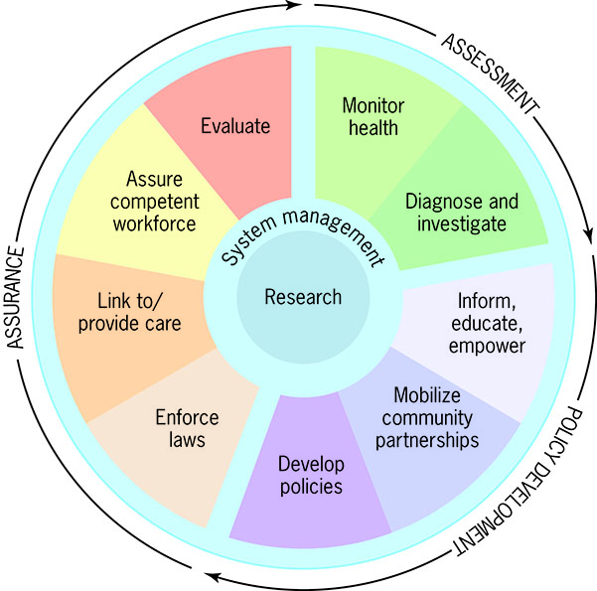
Core Functions of Public Health and 10 Essential Services
Reproduced from: Centers for Disease Control and Prevention (2014). The Public Health System and the 10 Essential Public Health Services. Available at http://www.cdc.gov/nphpsp/essentialservices.html

Slide 16
State Health Departments
Most organized into divisions or bureaus
Play many different roles
Can establish health regulations
Provide link between federal and local health agencies
Serve as conduits for federal funds aimed at local health departments
Have laboratory services available for local health departments

Slide 17
Local Health Departments
Responsibility of city or county governments
Jurisdiction often depends on size of population
State mandated services provided locally
Restaurants, public buildings, and public transportation inspections; detection and reporting of certain diseases; collection of vital statistics
Approximately 2,800 in the United States

Slide 18
Organization of Local Health Departments

Slide 19
Whole School, Whole Community, Whole Child (WSCC) Model
Schools under category of governmental health agency – funded by tax dollars
Schools have great potential for impacting community health
Ecological approach directed at the whole school
Expands on the 8 elements of the coordinated school health (CSH) approach
Expanded components – social and emotional climate, physical environment, community involvement, and family engagement

Slide 20
Quasi-Governmental Health Organizations
Some official health responsibilities; operate more like voluntary health organizations
Operate independently of government supervision
Derive some funding and work from government
Examples: American Red Cross, National Academy of Sciences, National Science Foundation

Slide 21
The American Red Cross
Official duties
Provide relief to victims of natural disasters
Serve as liaison between members of armed forces and their families during emergencies
Nongovernmental services
Blood drives, safety services, community volunteer services, international services
Part of international movements

Slide 22
Nongovernmental Health Agencies
Funded by private donations or membership dues
Arose due to unmet health need
Operate free from governmental interference
Meet specific IRS guidelines with tax status
Many types
Voluntary, professional, religious, social, philanthropic, corporate, service

Slide 23
Voluntary Health Agencies
Created by one or more concerned citizens that felt a specific health need was not being met by governmental agencies
Most exist at national, state, and local levels
National often focused on research, state links national with local offices, local often carry out programming
Usually combination of paid staff and volunteers

Slide 24
Purpose of Voluntary Health Agencies
Four basic objectives
Raise money to fund programs and/or research
Provide education to professionals and the public
Provide services to those afflicted
Advocacy
Fundraising is a primary activity
Examples, ACS, AHA, March of Dimes, MDA

Slide 25
Professional Health Organizations
Made up of health professionals who have completed specialized training and have met standards of registration/certification or licensure for their fields
Mission: to promote high standards of professional practice
Funded primarily by membership dues
Examples: American Medical Association, American Public Health Association

Slide 26
Philanthropic Foundations
Endowed institutions that donate money for the good of humankind
Fund programs and research on prevention, control, and treatment of many diseases
Some have broad support, others very specific
Examples: Bill and Melinda Gates Foundation, Commonwealth Fund, Robert Wood Johnson Foundation, local Community Foundations

Slide 27
Service, Social, and Religious Organizations
Many do not have health as primary mission, but make significant health-related contributions
Examples: Kiwanis, Elks, Shriners, Lions, FOP
Contributions of religious groups to community health are substantial
History of volunteerism, influence on families, donation of space, sponsorship of programs (food banks, shelters)

Slide 28
Corporate Involvement in Community Health
Biggest role is provision of healthcare benefits
Worksite health promotion programs aimed at lowering healthcare costs and reducing absenteeism
Safety, counseling, education courses, physical fitness centers

Slide 29
Discussion Questions
How have voluntary health organizations impacted health outcomes?
How does the Department of Health and Human Services impact individuals?
How can the World Health Organization overcome the obstacles they face?

