Slide 1
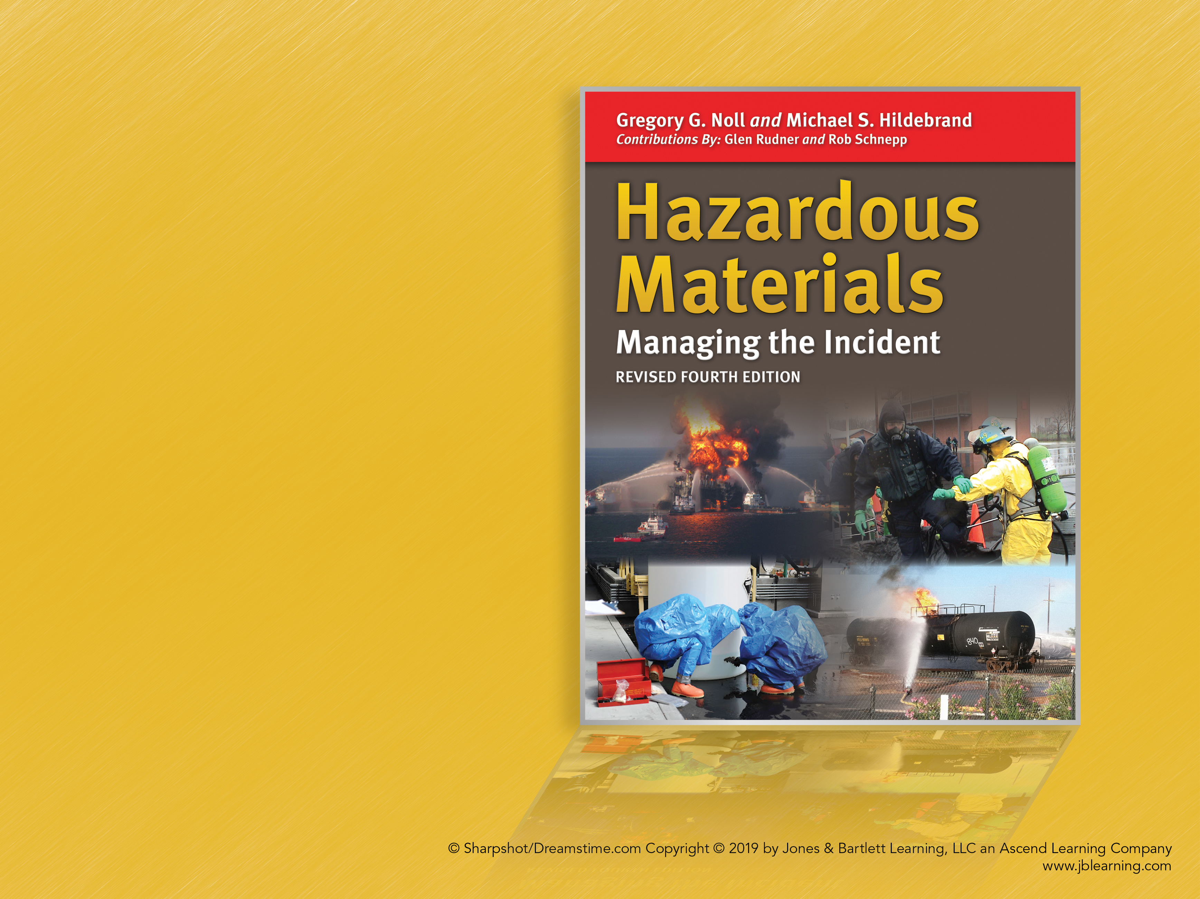
CHAPTER 4
The Eight Step Process©:
An Overview

Slide 2
Learning Objectives Overview
Knowledge Objectives
Skills Objectives

Slide 3
Introduction (1 of 2)
On-scene response operations must:
  Be based on a structured and standardized system of protocols and procedures
  Rely on standardized procedures to bring consistency to the tactical operation

Slide 4
Introduction (2 of 2)
The Eight Step Process© is widely used throughout the country by governmental and private sector hazardous materials response teams for the tactical management of hazardous materials emergencies.

Slide 5
Making the Transition (1 of 2)
Early critical factors include:
  Timely establishment of command and control
  Responder recognition of clues indicating hazardous materials
  Quickly gaining scene control and removing bystanders from problem

Slide 6
Making the Transition (2 of 2)
Basic considerations during the alerting, notification, and initial response phase include the following:
  Location of the incident?
  Available clues that hazmats involved?
  Reports or physical clues of any unusual odors?
  Any injuries or casualties involved?
  Any initial responders down?
  Any suspicious activity in the area?

Slide 7
The Eight Step Process© (1 of 2)
Outlines basic tactical functions
Flexible guideline
Recognizes that the majority of incidents involving hazardous materials are minor in nature
Expands as the scope and magnitude of the incident grows
Provides a consistent management structure

Slide 8
The Eight Step Process© (2 of 2)
These eight functions typically follow an implementation timeline at the incident:
  Site management and control
  Identify the problem
  Hazard assessment and risk evaluation
  Select personal protective clothing and equipment

Slide 9
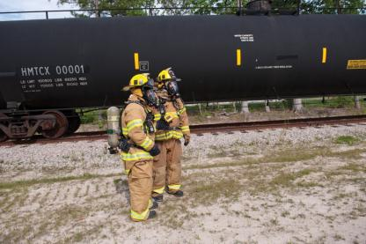
Step 1: Site Management and Control (1 of 3)
Function: Site management and control involves managing and securing the physical layout of the incident.
  Goal: Establish the playing field so that all subsequent response operations can be implemented safety and effectively.

Slide 10
Step 1: Site Management and Control (2 of 3)
Checklist:
  During the initial approach to the incident scene, avoid committing or positioning personnel in a hazardous position.
  Establish a staging area (Level I, II) for additional responding equipment and personnel.
  Establish a hot zone or inner perimeter as the “playing field.”

Slide 11
Step 1: Site Management and Control (3 of 3)
Checklist:
  Do not attempt to enter the area without the appropriate level of respiratory and skin protection, based on the hazards present.
  If civilians are injured and personal contamination is suspected, isolate all personnel until emergency decon can be established.
  Initiate public protective actions (PPA).

Slide 12
Step 2:
Identify the Problem (1 of 2)
Checklist:
  Survey the incident.
  Use clues for determining the identity of the materials involved.
  Consider factors in assessing the type of container involved.
  Conduct offensive or defensive reconnaissance, as necessary, to gather intelligence (or intel) on the situation.

Slide 13
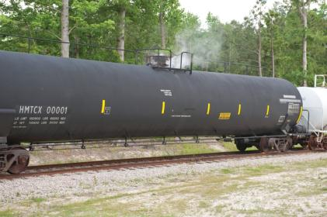
Step 2:
Identify the Problem (2 of 2)
Function: Identify the scope and nature of the problem.
Goal: Identify the scope and nature of the problem, including the type and nature of hazardous materials involved.

Slide 14
Step 3: Hazard Assessment and Risk Evaluation (1 of 5)
Function: The primary objective of the risk evaluation process is to determine whether or not responders should intervene, and what strategic objectives and tactical options should be pursued to control the problem.

Slide 15
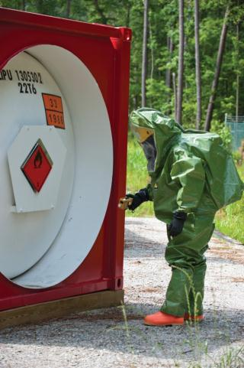
Step 3: Hazard Assessment and Risk Evaluation (2 of 5)
Goal: Assess the hazards present, evaluate the level of risk, and establish an incident action plan (IAP) to make the problem go away.

Slide 16
Step 3: Hazard Assessment and Risk Evaluation (3 of 5)
Checklist:
  Assess the hazards posed by the problem.
  Collect, prioritize, and manage hazard data and information from all sources, as appropriate.
  Utilize primary technical information centers available to public safety personnel.

Slide 17
Step 3: Hazard Assessment and Risk Evaluation (4 of 5)
Checklist:
  Air monitoring and the general hazmat behavior model are critical in implementing a risk-based response.
  Based on the risk evaluation process, develop your IAP.

Slide 18
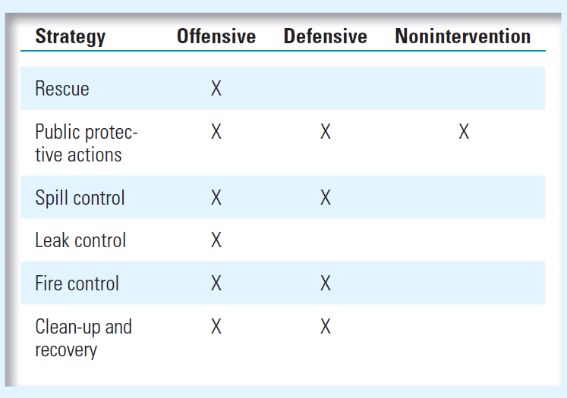
Step 3: Hazard Assessment and Risk Evaluation (5 of 5)

Slide 19
Step 4: Select Personal
Protective Clothing (1 of 5)
Function: Based on the results of the hazard and risk assessment process, emergency response personnel will select the proper level of personal protective clothing and equipment.

Slide 20
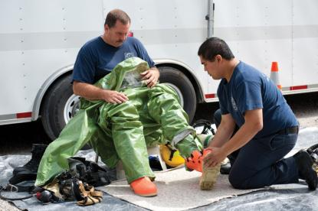
Step 4: Select Personal
Protective Clothing (2 of 5)
Goal:
  Ensure all emergency response personnel have the appropriate level of personal protective clothing and equipment (skin and respiratory protection) for the expected tasks.

Slide 21
Step 4: Select Personal
Protective Clothing (3 of 5)
Checklist:
  The selection of personal protective clothing will depend on the hazards and properties of the materials involved and the response objectives to be implemented.
  Several factors must be considered in evaluating the use of specialized protective clothing.

Slide 22
Step 4: Select Personal
Protective Clothing (4 of 5)
Checklist:
  Chemical vapor protective clothing—This is specialized chemical protective clothing, which, when used in conjunction with air-supplied respiratory protection devices, offers a sealed, integral level of full-body protection from a hostile environment.
  Ensure all emergency response personnel are using the proper protective clothing and equipment equal to the hazards present.

Slide 23
Step 4: Select Personal
Protective Clothing (5 of 5)
Checklist:
  Do not place personnel in an unsafe emergency situation or location.
  Order additional personnel and other specialized equipment and technical expertise early in the incident.

Slide 24
Step 5: Information
Management and
Resource Coordination (1 of 5)
Function: Refers to proper management, coordination, and dissemination of all pertinent data and information within the ICS in effect at the scene

Slide 25
Step 5: Information
Management and
Resource Coordination (2 of 5)
Goal: Provide for the timely and effective management, coordination, and dissemination of all pertinent data, information, and resources among all of the players

Slide 26
Step 5: Information
Management and
Resource Coordination (3 of 5)
Checklist:
  Confirm the ICP is in a safe area.
  Confirm a unified command organization is in place and all key response and support agencies are represented directly or through the liaison officer.
  Expand the ICS and create additional branches, divisions, or groups, as necessary.

Slide 27
Step 5: Information
Management and
Resource Coordination (4 of 5)
Checklist:
  Ensure all appropriate internal and external notifications have been made.
  Ensure safety procedures are part of all tactical briefings.

Slide 28
Step 5: Information
Management and
Resource Coordination (5 of 5)
Checklist:
  Make sure there is continuing progress toward solving the emergency in a timely manner.
  If activated, provide regular updates to the local/facility emergency operations center.

Slide 29
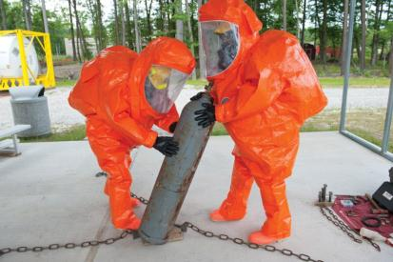
Step 6: Implement Response
Objectives (1 of 4)
Function: The phase where emergency responders implement the best available strategic goals and tactical objectives, which will produce the most favorable outcome

Slide 30
Step 6: Implement Response
Objectives (2 of 4)
Goal: Ensure the incident priorities (i.e., rescue, incident stabilization, environmental and property protection) are accomplished in a safe, timely, and effective manner.

Slide 31
Step 6: Implement Response
Objectives (3 of 4)
Checklist:
  Implement response objectives.
  Ensure any detection or monitoring equipment is operational and properly calibrated.

Slide 32
Step 6: Implement Response
Objectives (4 of 4)
Checklist:
  Ensure entry teams have been briefed prior to being allowed to enter the hot zone.
  Conduct regular monitoring of the hazard area to determine if conditions are changing.

Slide 33
Step 7: Decon and Clean-Up
Operations (1 of 4)
Function: Decontamination (decon) is the process of making personnel, equipment, and supplies safe by reducing or eliminating harmful substances (i.e., contaminants) that are present when entering and working in contaminated areas (i.e., hot zone or inner perimeter).

Slide 34
Step 7: Decon and Clean-Up
Operations (2 of 4)
Goal: Ensure the safety of both emergency responders and the public by reducing the level of contamination on scene and minimizing the potential for secondary contamination beyond the incident scene.

Slide 35
Step 7: Decon and Clean-Up
Operations (3 of 4)
Checklist:
  Ensure the technical decon operations are coordinated with tactical operations.
  Incidents involving large numbers of contaminated or potentially contaminated individuals will require the establishment of a mass decon operation following the basic principles of mass casualty decon.

Slide 36
Step 7: Decon and Clean-Up
Operations (4 of 4)
Checklist:
  Ensure proper decon of all personnel before they leave the scene.
  Establish a plan to clean up or dispose of contaminated supplies and equipment before cleaning up the site of a release.

Slide 37
Step 8: Terminate the Incident
(1 of 4)
Function: To terminate emergency response activities and begin the initiation of post-emergency response operations (PERO)

Slide 38
Step 8: Terminate the Incident
(2 of 4)
Goal: Ensure overall command is transferred to the proper agency when the emergency is terminated and all post-incident administrative activities are completed per local policies and procedures.

Slide 39
Step 8: Terminate the Incident
(3 of 4)
Checklist:
  Account for all personnel before securing emergency operations.
  Conduct incident debriefing session for on-scene response personnel.
  Ensure command is formally transferred from the lead response agency to the lead agency for all post-emergency response operations.

Slide 40
Step 8: Terminate the Incident
(4 of 4)
Checklist:
  Ensure public safety units are aware of any hazards remaining at the incident scene in the event emergency responders must return to the scene.
  Ensure the elements of the response are documented.
  Ensure all emergency equipment is decontaminated, reserviced, inspected, and placed back in service.

Slide 41
Summary (1 of 4)
Emergency response operations at incidents involving hazardous materials must always be based on a structured and standardized system of response protocols and procedures.

Slide 42
Summary (2 of 4)
The Eight Step Process© is a tool used for the tactical management of hazardous materials emergencies.
Although the level of equipment, training, and personnel may vary among organizations, there are fundamental functions and tasks that must be evaluated and implemented on a consistent basis.

Slide 43
Summary (3 of 4)
The eight functions within the Eight Step Process© are:
  Site management and control
  Identify the problem
  Hazard assessment and risk evaluation
  Select personal protective clothing and equipment

Slide 44
Summary (4 of 4)
The eight functions within the Eight Step Process© are:
  Information management and resource coordination
  Implement response objectives
  Decon and clean-up operations
  Terminate the incident

