Slide 1
Chapter 1
An Overview of Health Care Management

Slide 2
Learning Objectives
Define health care management and the role of the health care manager.
Differentiate among the functions, roles, and responsibilities of health care managers.
Compare and contrast the key competencies of health care managers.
Identify current areas of research in health care management.

Slide 3
Direct vs Non-Direct Care
Direct care settings: provide care directly to a patient, resident, or client who seeks services from the organization.
Non-direct care settings: not directly involved in providing care to persons needing health services; support the care of individuals through products and services made available to direct care settings.

Slide 4
Direct Care Employment Growth
The BLS projects that employment of medical and health services managers is expected to grow 23 percent from 2012 to 2022.
Greatest growth in managerial positions will occur in outpatient centers, clinics, and physician practices.
Largest growth numbers will be in hospitals due to size of sector.

Slide 5
Non-Direct Care Employment Growth
Consulting firms, pharmaceutical companies, associations, and medical equipment companies provide significant assistance to direct care organizations.
It is expected that growth will also occur in managerial positions in non-direct care settings.

Slide 6
Managers Needed
Managers are needed to make certain that organizational tasks are carried out in the best way possible to achieve organizational goals; and that appropriate resources, including financial and human resources, are adequate to support the organization.

Slide 7
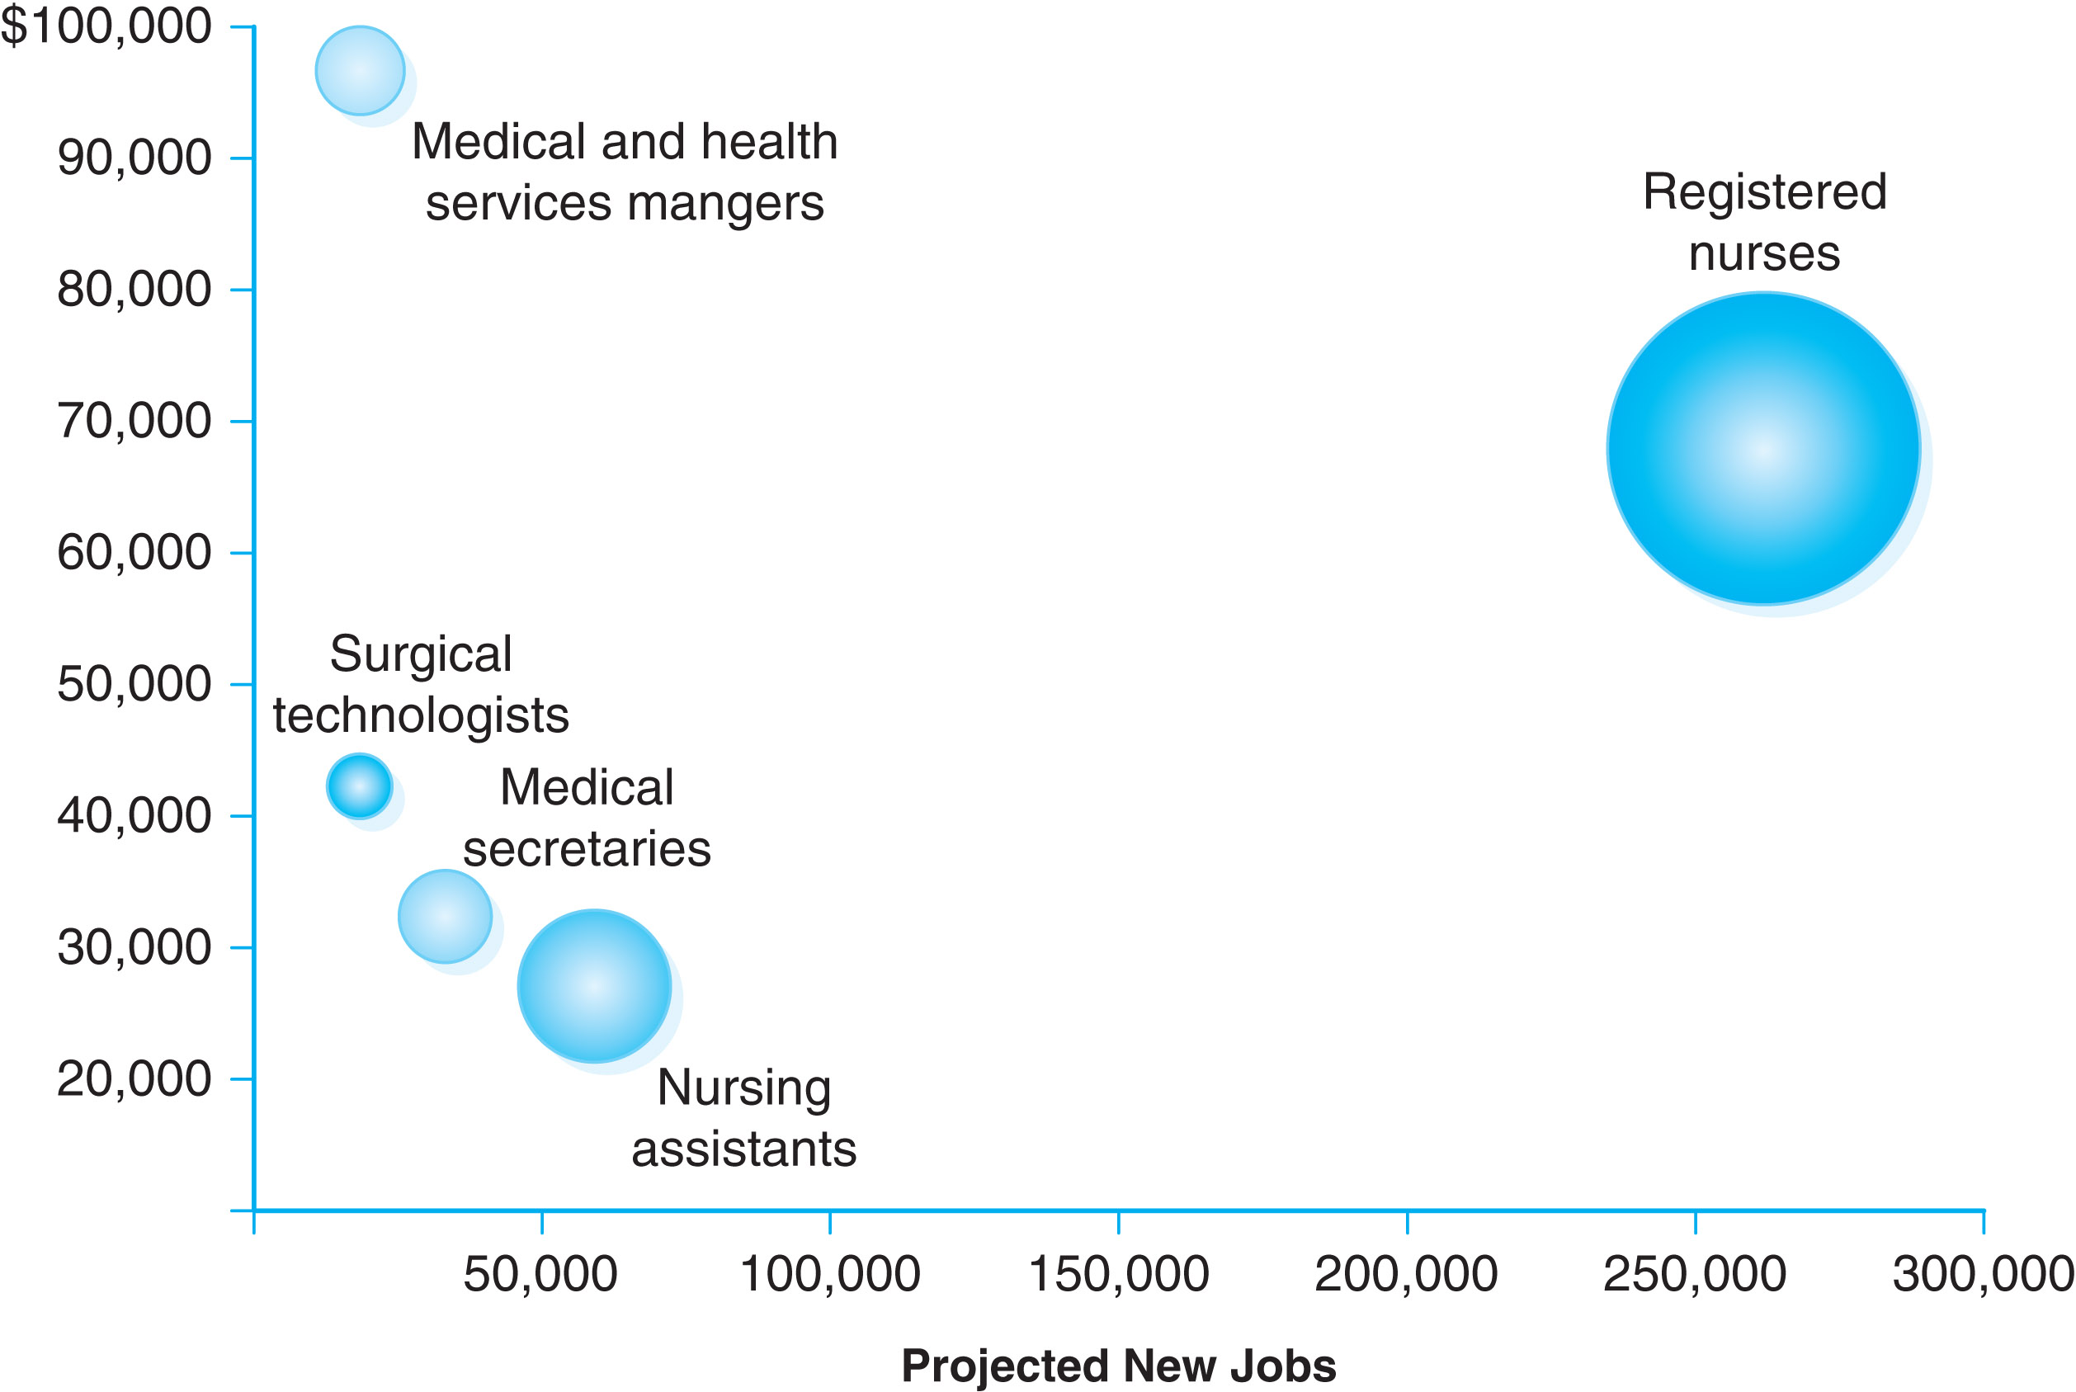
Figure 1-1
U.S. Bureau of Labor Statistics, Employment Projections program (projected new jobs, 2012–22) and Occupational Employment Statistics Survey (employment and median annual wages, May 2013).

Slide 8
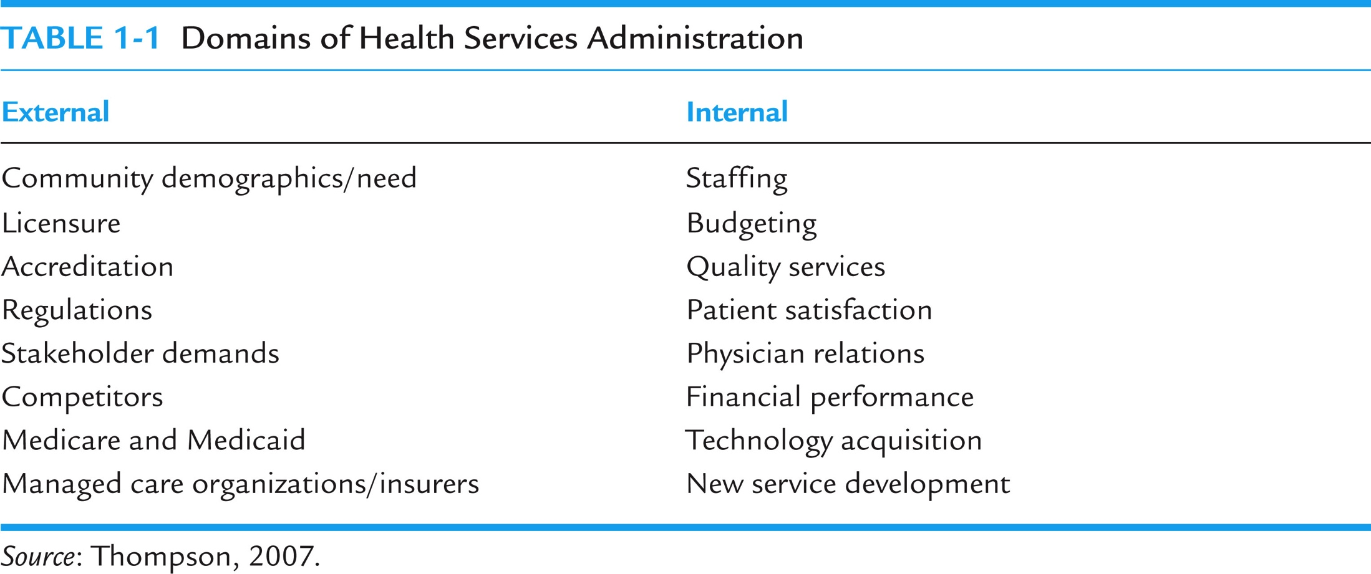
Table 1-1

Slide 9
Definition of Management
The process, comprised of social and technical functions and activities, occurring within organizations for the purpose of accomplishing predetermined objectives through human and other resources.
Managers work through others to accomplish organizational goals.

Slide 10
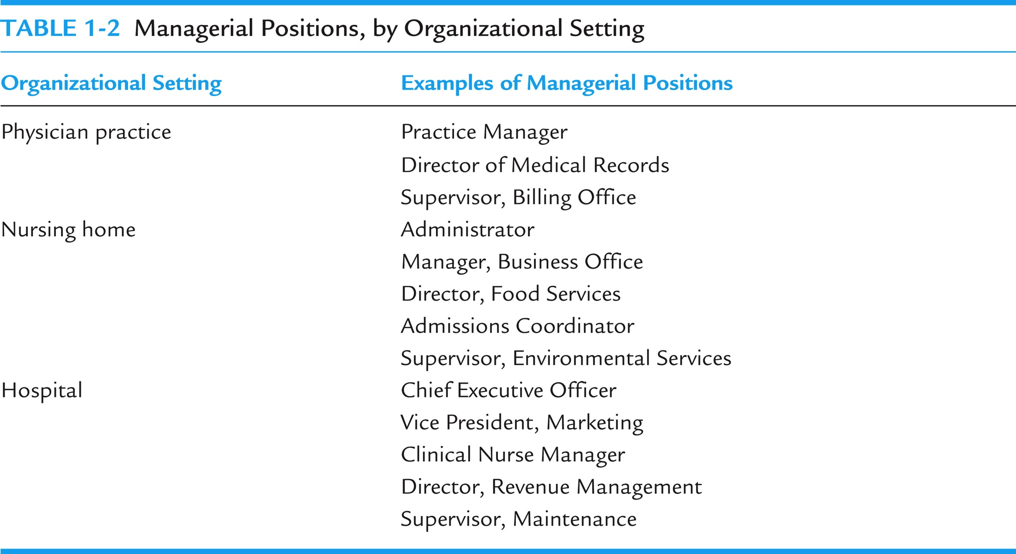
Table 1-2

Slide 11
Planning
This function requires the manager to set a direction and determine what needs to be accomplished. It means setting priorities and determining performance targets.

Slide 12
Organizing
Refers to the overall design of the organization or the specific division, unit, or service for which the manager is responsible. Further, it means designating reporting relationships and intentional patterns of interaction. Determining positions, teamwork assignments, and distribution of authority and responsibility are critical components of this function.

Slide 13
Staffing
Acquiring and retaining human resources.
Developing and maintaining the workforce through various strategies and tactics.

Slide 14
Controlling and Directing
Controlling: monitoring staff activities and performance and taking the appropriate actions for corrective action to increase performance.
Directing: initiating action in the organization through effective leadership and motivation of, and communication with, subordinates.

Slide 15
Decision Making
This function is critical to all of the aforementioned management functions and means making effective decisions based on consideration of benefits and the drawbacks of alternatives.

Slide 16
Competencies: Conceptual Skills
Those skills that involve the ability to critically analyze and solve complex problems.
Examples:
a manager conducts an analysis of the best way to provide a service
a manager determines a strategy to reduce patient complaints regarding food service

Slide 17
Competencies: Technical Skills
Those skills that reflect expertise or ability to perform a specific work task.
Examples:
a manager develops and implements a new incentive compensation program for staff
a manager designs and implements modifications to a computer-based staffing model

Slide 18
Competencies: Interpersonal Skills
Those skills that enable a manager to communicate with and work well with other individuals, regardless of whether they are peers, supervisors, or subordinates.
Examples:
A manager counsels an employee whose performance is below expectations.
A manager communicates to subordinates the desired performance level for a service for the next fiscal year.

Slide 19
Hierarchy and Control
Management positions exist at lower levels, middle-management levels, and upper levels, i.e., senior management.
Hierarchy of management means that authority, or power, is delegated downward in the organization, and that lower-level managers have less authority than higher-level managers whose scope of responsibility is much greater.

Slide 20
Vertical Structure
Size and complexity of the specific health services organization will dictate the particular structure.
Larger organizations—such as large community hospitals, hospital systems, and academic medical centers—will likely have deep vertical structures reflecting varying levels of administrative control for the organization.

Slide 21
Matrix Structure
These include team-based models and service line management models.
The matrix model recognizes:
that a strict functional structure may limit the organization’s flexibility to carry out the work, and
that the expertise of other disciplines is needed on a continuous basis.

Slide 22
Matrix Examples
Team: functional staff, such as nursing and rehabilitation personnel, are assigned to a specific program such as geriatrics and report for programmatic purposes to the program director of geriatrics.
Service Line: manager heads a specific clinical service line (e.g., cardiology) with accountability for staffing, resource acquisition, budget, and financial control.

Slide 23
Focus of Management
Self Management: the individual manager must be able to effectively manage himself or herself, as well as time, information, space, and materials; being responsive and following through with peers, supervisors, and clients.
Maintaining a positive attitude and high motivation; developing and applying appropriate skills and competencies.

Slide 24
Unit/Team Management
The expertise of the manager at this level involves managing others in terms of effectively completing the work through task interdependence.
Includes assigning work tasks, review and modification of assignments, monitoring and review of individual performance, and carrying out the management functions described previously.

Slide 25
Organizational Management
Managers must work together as part of the larger organization to ensure organization-wide performance and organizational viability.
Success of the organization depends upon the success of its individual parts, and effective collaboration is needed to ensure that this occurs.

Slide 26
Talent Management
Recruitment, retention, training, and development of highly skilled employees is critical to health care organizations.
Health care organizations compete with each other for the brightest and the best talent.
Managers look for and keep the talent!

Slide 27
Organizational Culture, Values, Mission, and Vision
Organizational culture: the beliefs, attitudes, and behaviors that are shared among organizational members.
Values: principles the organization believes in that guide activities.
Mission: the organization’s purpose.
Vision: a desired future state describing what the HSO will be recognized and known for.

Slide 28
Ensuring High Performance
High-performance organizations are results oriented.
One framework has pillars of excellence for the specific goals of the organization: people (employees, patients and physicians), service, quality, finance, and growth (Studer, 2003).

Slide 29
Ensuring High Performance
Another framework speaks of “champions” and the “championship process” measures of performance; including
Governance and strategic management; clinical quality, including customer satisfaction; clinical organization (caregivers); financial planning; planning and marketing; information services; human resources; and plant and supplies (Griffith, 2000).

Slide 30
Stakeholders
Stakeholders, including insurers, state and federal governments, and consumer advocacy groups, are expecting, and in many cases demanding, acceptable levels of performance in health care organizations.
Want to make sure that services are provided in a safe, convenient, low­-cost, and high-quality environment.

Slide 31
Leadership Development and Succession Planning
Leadership development is defined as educational interventions and skill-building activities designed to improve the leadership capabilities of individuals (McAlearney, 2005; Kim & Thompson, 2012).
Leadership development activities include structured courses, mentoring, 360-degree feedback, personal coaching, job enlargement.

Slide 32
Leadership Development and Succession Planning (Cont’d.)
Succession planning: the concept of taking actions to ensure that staff can move up in management roles within the organization, in order to replace those managers who retire or move to other opportunities in other organizations.
Now more than ever before, succession planning is needed at all levels, not just senior management.

Slide 33
Innovation and Change Management
HSOs cannot remain static!
Environmental forces require HSOs to adapt.
Achieving and sustaining high performance (outcomes or results) requires making improvements to organizational structure and processes.

Slide 34
Innovation and Change Management (Cont’d.)
Two types of innovation: management innovation and operational innovation (Hamel, 2007).
Change management: organizational change is a structured management approach to improving the organization and its performance, and is based on knowledge of performance gaps (Thompson, 2010).

Slide 35
Health Care Policy
Managers must be knowledgeable about health policy matters under consideration at the state and federal levels that affect organizations and health care delivery.
Often organizations have designated staff to monitor this—but the manager must stay current or lose opportunities. Professional organizations such as ACHE and MGMA help with this.

Slide 36
Current Research in Health Care Management
Best practices of managers: employee engagement, staff acquisition and development, staff frontline empowerment, and leadership alignment and development.
Effectiveness of leadership development programs: talent reviews, 360-degree feedback, career development planning, job rotations, developmental assignments.

