Slide 1
Theories and Models Commonly Used for Health Promotion Interventions
CHAPTER 7

Slide 2
Chapter Objectives
Explain how constructs and concepts in theories and models impact the health of priority populations.
Explain why health promotion interventions should be planned using theoretical frameworks
Describe how the concept of ecological perspective relates to and differs from intrapersonal and interpersonal theories.
Explain ways in which you might use the theories and models presented in this chapter to inform evaluation.

Slide 3
Key Terms (1 of 2)
Theory—set of interrelated concepts, definitions, and propositions that present a systematic view of a situation by indicating relations among variables to explain and predict events of the situation (Kerlinger, 1986)
Model—composite of ideas and concepts taken from multiple theories and used together (Hayden, 2019)

Slide 4
Key Terms (2 of 2)
Concepts—primary building blocks of a theory (Glanz et al., 2008)
Construct—concept used with a specific theory
Variable—measurement of a construct

Slide 5
Introduction
Theories are the backbone of processes used to plan, implement and evaluate health promotion interventions.
Using theories to guide work is consistent with evidence-informed and evidence-based practice.
There is no “best” theory.
The best theory is the one that meets the needs of any given program.

Slide 6
Types of Models and Theories
Planning models and theories—those used to plan, implement and evaluate health promotion programs
Behavior change theories—those that help to explain how change takes place

Slide 7
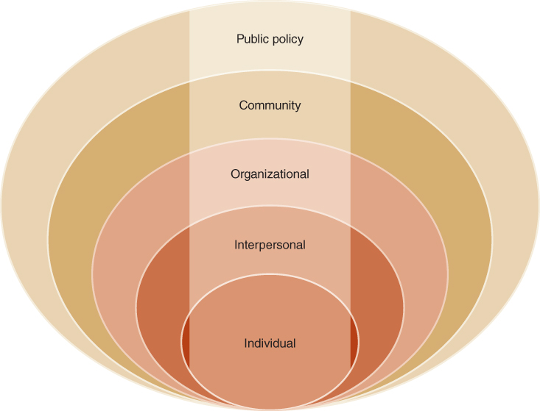
Behavior Change Theories (1 of 2)
Socioecological approach (also referred to as the ecological perspective) has the underlying concept that human behavior shapes and is shaped by multiple levels of influence
Figure 7.2 Social Ecological Model.
Reproduced from Glanz, K. (n.d.). Social and behavioral theories. In Office of Behavior & Social Science Research, National Institutes of Health, Department of Health and Human Services, e-Source: The authority on
behavioral & social science research (Ch. 5). https://obssr.od.nih.gov/sites/obssr/files/Social-and-Behavioral-Theories.pdf

Slide 8
Behavior Change Theories (2 of 2)
Types of behavior change theories
Continuum theories—identify variables that influence actions and combine them into an equation to predict action
Stage theories—have an ordered set of categories into which people are classified and identify factors that could induce movement from one category to the next

Slide 9
Intrapersonal Level Theories (1 of 13)
Theory of planned behavior (TPB)
Value-expectancy theory—explains how beliefs and attitudes influence behaviors
Foundation was theory of reasoned action (TRA)
Most useful with volitional behaviors
Intention driven by attitudes toward the behavior, subjective norm, and perceived behavioral control
Actual behavioral control along with intention determines impacts performance.

Slide 10
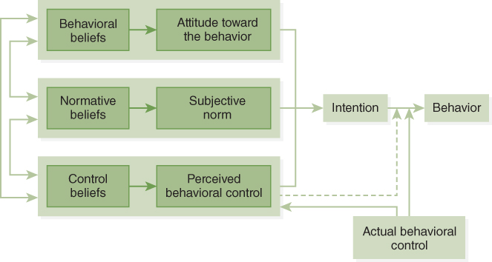
Theory of Planned Behavior Diagram
Figure 7.3 Theory of Planned Behavior Diagram.
Copyright © 2019 by Icek Ajzen. Reprinted with permission.

Slide 11
Intrapersonal Level Theories (2 of 13)
Health Belief Model (HBM)
Value-expectancy theory
Health-related action depends on simultaneous occurrence of three classes of factors
Motivation
Perceived threat
Perceived barriers
Self-efficacy impacts perceived barriers

Slide 12
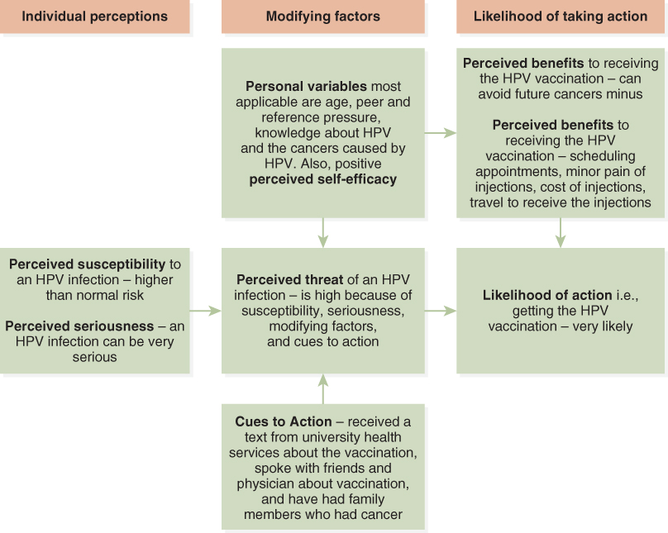
Health Belief Model
Figure 7.4 Application of the Health Belief Model to HPV vaccination.

Slide 13
Intrapersonal Level Theories (3 of 13)
The Transtheoretical Model (TTM)
Sometimes referred to as the Stages of Change Model
Helps explain how people move through change
Core constructs include—stages of change, the processes of change, decisional balance, self-efficacy, and temptation

Slide 14
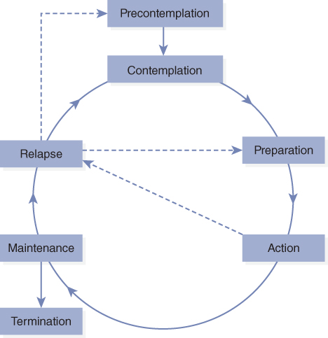
Transtheoretical Model
Figure 7.6 The Stages of Change.
Reproduced from Goldstein, M. G., DePue, J., Kazura, A., & Niaura, R. (1998). Models for provider–patient interaction: Applications to health behavior change. In S. A. Shumaker, E. B. Schron, J. K. Ockene, & W. L. McBee (Eds.), The handbook of health behavior change (2nd ed., pp. 85–113). Springer Publishing Company.

Slide 15
Intrapersonal Level Theories (4 of 13)
Stimulus Response (SR) Theory
Stimulus response denotes that there is a stimulus presented and a subsequent behavior is preformed.
Behavior frequency is determined by reinforcements; reinforcement has a strengthening effect on behaviors.
Punishment suppresses or decreases the frequency of a behavior.
Reinforcement and punishment can be either positive (adding something) or negative (taking away something).

Slide 16
Intrapersonal Level Theories (5 of 13)
Stimulus Response (SR) Theory (cont.)
Positive reinforcement (adding a reward)
Negative reinforcement (removing a negative reinforcer)
Positive punishment (adding a negative reinforcer, i.e., aversive stimulus)
Negative punishment (removing a positive reinforcer)

Slide 17
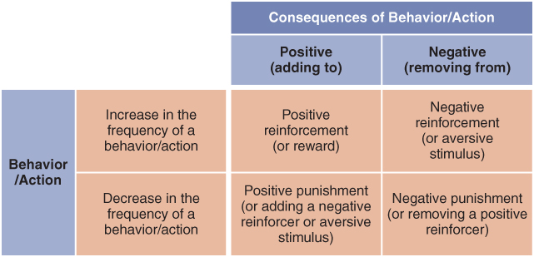
Stimulus Response Theory
Figure 7.7 2 × 2 Table of the Stimulus-Response Theory.

Slide 18
Intrapersonal Level Theories (6 of 13)
Protection Motivation Theory (PMT)
A value-expectancy theory—provides explanations of effects of persuasive communication theory on attitudes and behavior
Cognitive assessment of threat to one’s health
Threat appraisal (rewards minus sum of severity and vulnerability)
Coping appraisal (response efficacy and self-efficacy)
Outcome of combined appraisals determines behavior

Slide 19
Intrapersonal Level Theories (7 of 13)
Elaboration Likelihood Model of Persuasion (ELM)
Developed to explain how persuasion messages aimed at attitude change were received
Modifying attitudes formed by
High degree of thought (central process route)
Low degree of thought (peripheral process route)
Elaboration—amount of cognitive processing
Many things can impact elaboration.

Slide 20
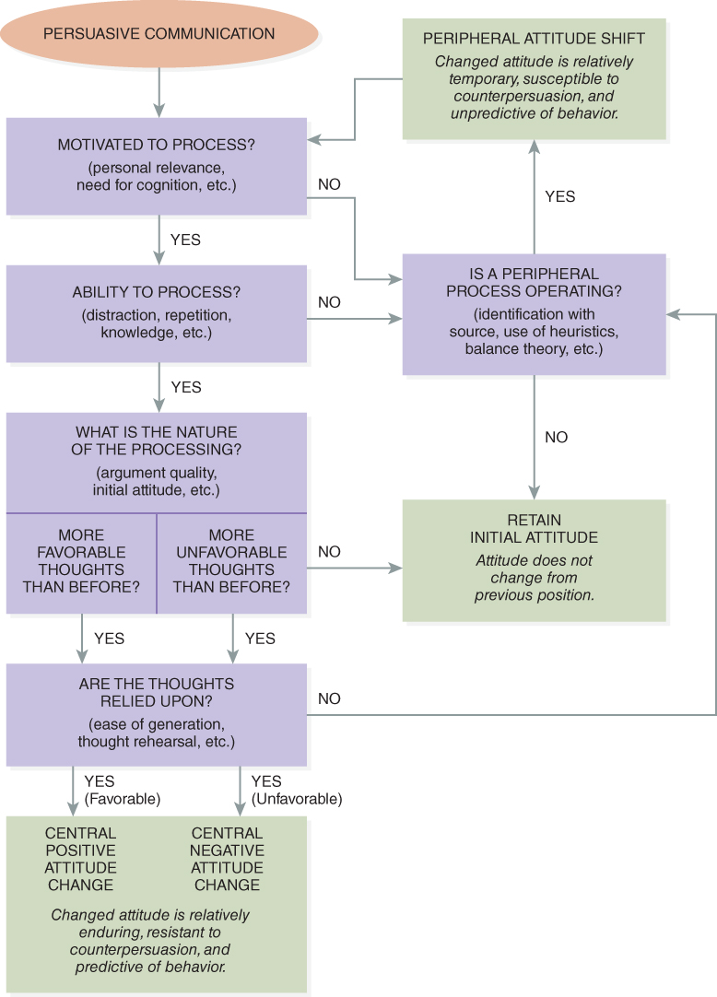
Elaboration Likelihood Model of Persuasion (ELM)
Figure 7.8 The Elaboration Likelihood Model of Persuasion (ELM).
Petty, R. E., Barden, J., & Wheeler, S. C. (2009). The elaboration likelihood model of persuasion: Developing health promotions for sustained behavioral change. In R. J. DiClemente, R. A. Crosby, & M. C. Kegler (Eds.), Emerging theories in health promotion practice and research (2nd ed., pp. 185–214). Jossey-Bass. Reprinted with permission.

Slide 21
Intrapersonal Level Theories (8 of 13)
Information-Motivation-Behavioral (IMB) Skills Model
Information, motivation, and skills are fundamental determinants of preventive behavior.
Information must be relevant and serve as personal guide to preventive behavior.
Personal and social motivation are needed to act.
Skills include a person’s objective ability and self-efficacy to perform preventive behavior.
Information, motivation, and skills must be based on needs.

Slide 22
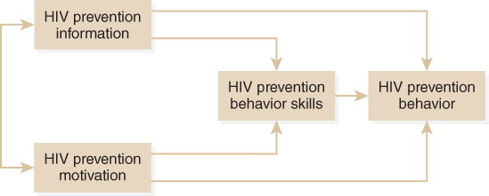
Information-Motivation-Behavioral (IMB) Skills Model
Figure 7.9 The Information-Motivation-Behavioral Skills Model of HIV Prevention.
Reproduced from Fisher, J. D., & Fisher, W. A. (1992). Changing AIDS-risk behavior. Psychological Bulletin, 111 (3), 455–474.

Slide 23
Intrapersonal Level Theories (9 of 13)
Precaution Adoption Process Model (PAPM) Model
Stage model
Best used when using a new precaution (e.g., immunization) or abandoning a risky behavior (e.g., not wearing a safety belt); single step behaviors, not those that require gradual change over time
Includes seven stages; a person can be “staged” by using a series of questions.

Slide 24
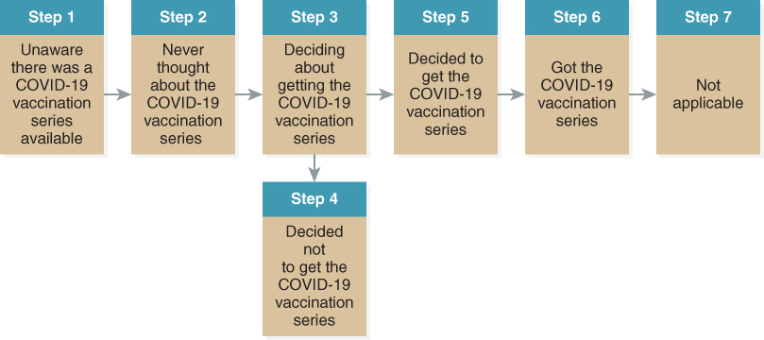
Precaution Adoption Process Model (PAPM)
Figure 7.10 Application of the Precaution Adoption Process Model to COVID-19 Vaccine Series.

Slide 25
Interpersonal Level Theories (10 of 13)
Social Cognitive Theory (SCT)
SCT combines stimulus response theory and cognitive theories.
SCT explains human functioning in terms of triadic reciprocal causation.
Internal personal factors (cognitive, affective, and biological events), behavioral patterns, and environmental influences interact and influence one another bidirectionally.

Slide 26
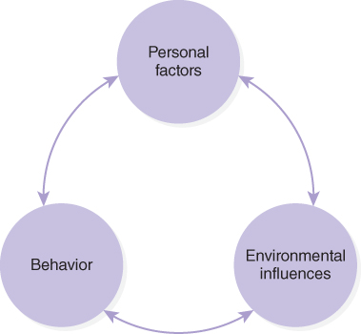
Interpersonal Level Theories (11 of 13)
Figure 7.11 Social Cognitive Theory.

Slide 27
Interpersonal Level Theories (12 of 13)
Social Cognitive Theory (SCT) constructs
Reinforcement—direct, vicarious, and self
Behavioral capability
Expectations
Expectancies
Self-regulation or self-control
Self-efficacy—efficacy expectations and outcome expectations; collective efficacy
Emotional coping response
Reciprocal determinism
Locus of control—internal and external

Slide 28
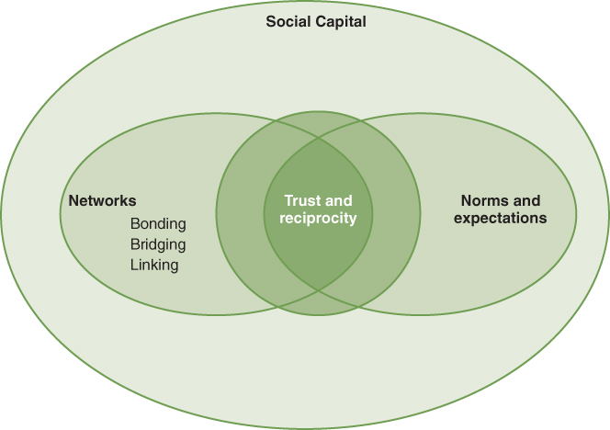
Interpersonal Level Theories (13 of 13)
Social Capital Theory
Relationships and structures within a community
A collective asset of the community not individuals
Types of networks—bonding, bridging, and linking
Figure 7.12 Social Capital.
Information from Hayden, J. (2019). Introduction to health behavior theory (3rd ed.). Jones & Bartlett Learning.

Slide 29
Interpersonal Network Theories
Social Network Theory
Some say not a theory, but rather concepts that describe functioning social relationships.
Social network—web of social relationships that surround people and the characteristics of the web
Research shows networks can support health status, but research does not say how much or what makes up a good network.
There are various types of networks.

Slide 30
Community Level Theories (1 of 4)
Community level theories
Those that apply the last five levels of the ecological perspective—institutional, community, public policy, environmental, and culture
Explore how social systems function and change
Include community organizing and developing

Slide 31
Community Level Theories (2 of 4)
Diffusion theory
Explains the spread of innovations (something new) through a population
Useful in health promotion to help planners create interventions or messaging for people in various categories

Slide 32
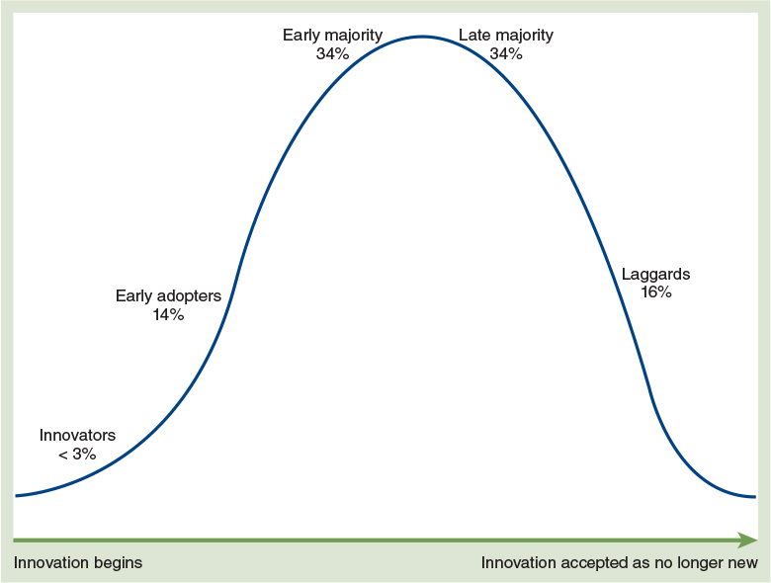
Community Level Theories (3 of 4)
Figure 7.14 Diffusion of Innovation.

Slide 33
Community Level Theories (4 of 4)
Community Readiness Model (CRM)
Stage model
Community readiness—degree to which a community is willing and ready to take action
Stages include—no awareness, denial, vague awareness, preplanning, preparation, initiation, stabilization, confirmation/expansion, and professionalism

Slide 34
Relapse and Its Prevention
Relapse—failure to change or modify a behavior
Lapse—a single slip
Recidivism is a problem in health behavior change attempts.
Planners need to consider relapse prevention (i.e., planning to deal with high-risk situations for program participants)

Slide 35
Theory/Model Selection (1 of 2)
Recognize behavior (change) is the most likely intervention point.
Need to define public health problems in terms of behaviors that contribute to the problem.

Slide 36
Theory/Model Selection (2 of 2)
Steps to identify the most appropriate theory
Develop a problem statement.
Identify a target behavior.
Define the priority population.
Conduct a functional assessment.
Select a theory or model.
Develop the intervention.

Slide 37
Limitations of Theory
No one theory/model is useful in all situations.
All theories/models have limitations.
Some theories just focus on reinforcement, others consider the input of cognition, while neatly placing people in stages based on characteristics.
Several different author groups have identified the various limitations of the theories/models.

Slide 38
Summary (1 of 2)
Two major categories of theories and models—planning and behavior change
Many theories/models are available to planner; no one theory/model is best.

Slide 39
Summary (2 of 2)
Theories/models are important because they provide information about why people are, or are not, engaging in health-enhancing behaviors; what factors to consider when creating interventions; and what factors to look for when evaluating a program.
This chapter used continuum and stage groups to categorize the behavior change theories/models.

