Slide 1

Chapter 8
Artifacts and Troubleshooting

Slide 2
Chapter Outline
Artifacts
ECG Artifact
Movement Artifact
Slow-Wave Artifact
Snore Artifact
Sixty-Hz Interference
Muscle Artifact
Electrode Popping
Pen Blocking
Improper Gain or Sensitivity Settings
Improper Filter Settings
Correcting Artifacts

Slide 3
Learning Objectives
Define artifacts and discuss their significance.
Identify several of the most common types of artifacts.
Learn multiple methods of correcting the artifacts discussed.
Learn general troubleshooting techniques.

Slide 4
Artifacts
Artifacts are unwanted signals that often obscure the recording.
Artifacts can come either directly from the patient or from the environment.
The technician should do his/her best to eliminate artifacts from the recording, but he/she first must recognize an artifact!

Slide 5
Artifacts
Physiologic artifacts originate from the patient.
  ECG
  Movement
  Sway
  Snore
Environmental artifacts originate from sources other than the patient.
  60 Hz
  Electrode popping
  Pen blocking

Slide 6
ECG Artifact
Problem: ECG contamination found in channels other than ECG.
You can confirm this artifact when it lines up directly with your ECG channel.
Solutions include:
  Move the affected electrodes off the ECG pulse.
  Re-reference if in one channel.
  Double reference if in multiple channels (common mode rejection).

Slide 7
Movement Artifact
Problem: Bursts of high amplitude activity that obscures most channels.
Mostly seen during wake or arousals when the patient is moving.
Solution: This problem resolves on its own when the patient relaxes and falls asleep. Making the patient feel relaxed will help eliminate this.

Slide 8
Slow-Wave Artifact
Problem: High amplitude, rhythmic slow waves seen in the EEG channels.
  Sweat
  Respiratory effort
  Sway
Solution: Address the underlying problem.
  Sweat: Drying off the area, reapply electrode(s), cool patient
  Respiratory: Reposition the patient or re-reference
  Sway: Re-secure the headbox

Slide 9
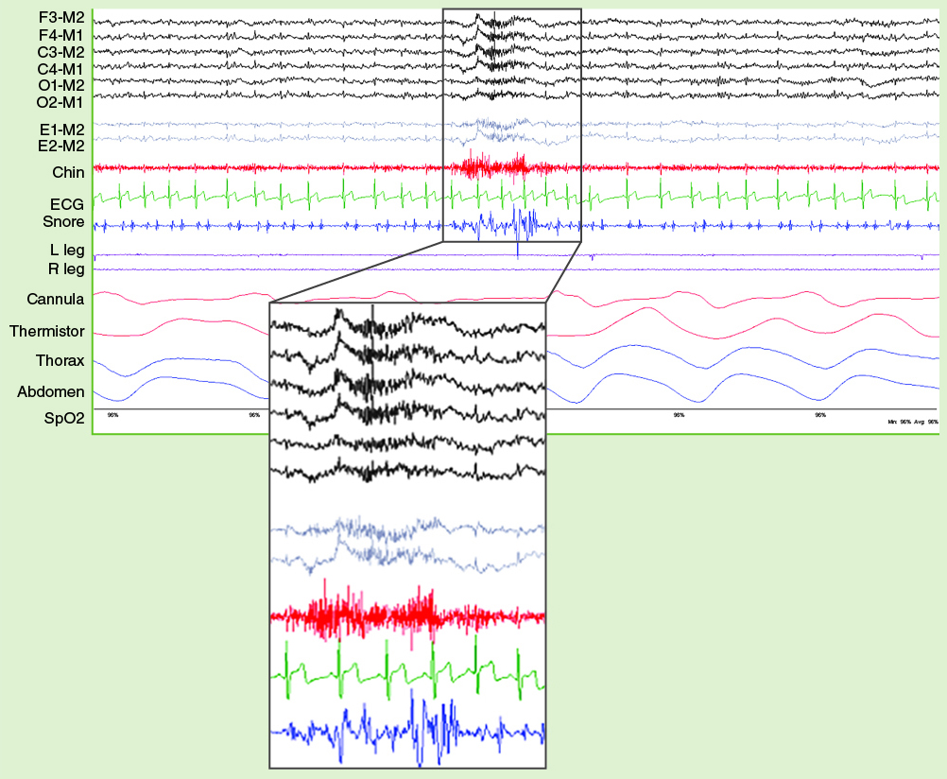
Snore Artifact
Problem: Bursts of high amplitude fast frequencies in channels other than the snore channel.
Solution: This problem will resolve itself when the snoring is eliminated.
Figure 8-19 Another example of snore artifact.

Slide 10
Sixty-Hz Interference
Problem: High-amplitude, fast (60 Hz) frequency that can occur in any AC channel and obscures the underlying data.
The most common cause is high electrode impedances and/or interference from other equipment.
Solution: Address the underlying problem.
  Re-prep the skin and reapply the high-impedance electrode (over 5,000 ohms).
  Remove electrical devices from the bed such as cell phones, DVD players, etc.
  Use the notch filter as a last resort only!
  Fix the problem. Don’t cover it up with the filter!

Slide 11
Muscle Artifact
Problem: High-frequency muscle activity that contaminates a channel not designed to collect muscle activity.
Commonly seen in the EEG and EOG channels when a patient is anxious or clenches the jaw or grinds their teeth.
Solution: Be patient. Muscle artifact is most often observed when the patient is awake and tends to gradually disappear as the patient relaxes and enters sleep.

Slide 12
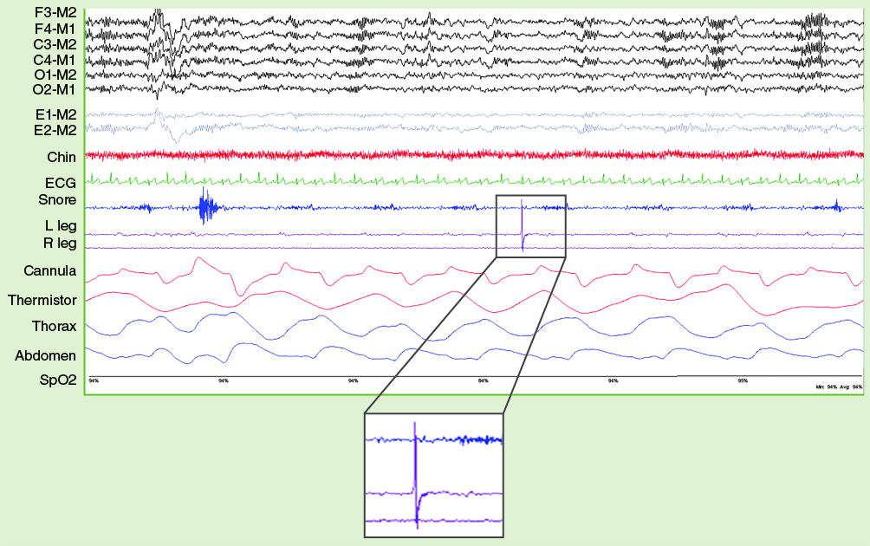
Electrode Popping
Problem: Short bursts of high amplitude distorted or spike waves that appear intermittently on channel.
Usually caused by a loose connection (poor skin adherence) or a faulty or broken wire.
Solution: Fix the problem.
  Reapply the affected electrode or replace if necessary.
Figure 8-32 A single electrode pop on the leg.

Slide 13
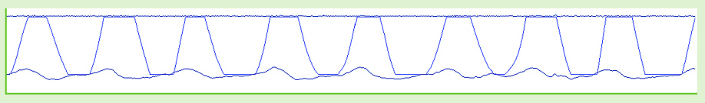
Pen Blocking
Problem: The waveforms “blocks” or “squares off” as a result of the wave being too high for the tracing to capture.
Solution: Decrease the gain. This will allow the wave to deflect fully within the new gain parameter.
Figure 8-33 Pen blocking occurs when the gain is set too high to allow the pen to remain within the channel’s upper and lower parameters.

Slide 14
Improper Gain or Sensitivity Settings
Gain and sensitivity both refer to the height of the waves.
Improper settings of these controls can cause the waves to be too high or too low.
The unit of measure and their effect on wave height differs.
Increase Gain = Height
Increase Sensitivity = Height

Slide 15
Improper Filter Settings
Filters adjustments should generally not be used to correct artifacts because it is likely to eliminate relevant waveforms intended to be recorded from the patient.
For example, if the LFF on an EEG channel is increased from the recommended setting of 0.3 Hz to 3 Hz, it will attenuate the slow EEG waves and delta wave activity will no longer be visible.

Slide 16
Correcting Artifacts
How do you know where the problem is?
** Answer:
Look at your montage.
The technician must determine “where” the problem is and “what” the problem is before he/she can fix it.

Slide 17
Correcting Artifacts
Determining what (type): Analyze the intruding signal to determine its approximate amplitude and frequency.
Determining where: Does the artifact affect one or several channels?
  If one channel, the source is likely the exploring electrode.
  If more than one channel, the source is likely a common reference.
  If present in all channels, the patient may be moving, the source could be an external electrical device, or the ground or main reference electrode may be problematic.

Slide 18
Correcting Artifacts
Are the electrode impedances under 5,000?
Are all electrical devices off the patient’s bed?
Are the electrodes plugged into the head box correctly?
Is the head box securely attached to the cable?
Is the cable security attached to the machine?
Is the patient restless or sweating?
Does the montage match the waveforms?
Are the machine settings/filters appropriate?

Slide 19
Correcting Artifacts
Follow the signal pathway starting at the patient interface.
The most common source of artifact is poor electrode preparation. Don’t underestimate the power of impedance values.
Use biocalibrations to reconfirm good signal quality.
Correct problems before lights out!

